Slide 1

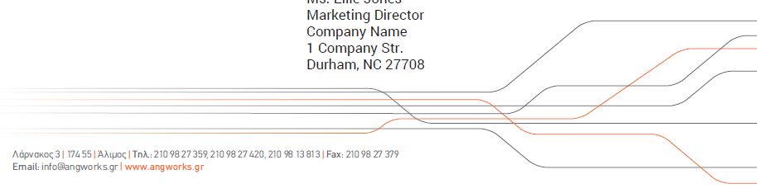
The Leader in Electromechanical Construction

Slide 2
Quality, Safety, Service.

Slide 3
A&G Profile
Goals & Strategy
Health & Safety
Specialized Services
Client Network
Project References
Benefits At-a-Glance

Slide 4
A&G Profile

Slide 5
Who We Are
A&G specializes in a wide array of installation, maintenance, and consulting services related to every application of electrical construction. Our extensive knowledge in modern electrical & mechanical engineering allows us to deliver effective, integrated solutions to large-scale commercial and industrial projects throughout Greece and beyond.
We fully undertake the project design, procurement, and installation of electrical systems, as well as the maintenance thereafter, while bearing in mind the importance of efficiency and consistency.
Since the establishment of A&G in 2007, the main objective of its founders was to create a service company in the field of electrical construction, oriented to the innovation of new technologies and the highest quality standards.
A&G has since developed into one of the leading companies in the industry. We are widely recognized for our attention to detail, technical expertise, strict adherence to safety guidelines, and have built a reputation for being one of the most well organized electrical construction firms.

Slide 6
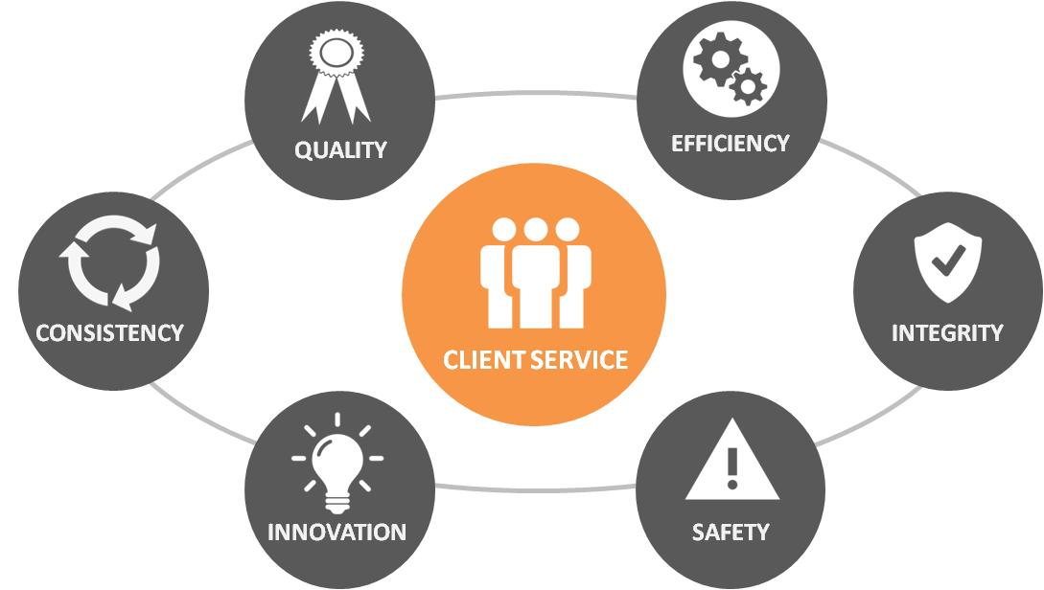
Value System
The most significant element of our success can be attributed to the client-centric philosophy, we have adopted deep into our corporate culture. We approach each project with a fresh perspective and develop solutions aimed at meeting your specific needs.
At A&G we recognize that integrity is a vital factor of success in a B2B environment. We consider our clients actual partners, who join forces with us to achieve common objectives. For this reason, client service is placed at the core of our value system.

Slide 7
The A&G Team
The A&G executive management team, whose collective experience spans across 20+ years in the fields of Electrical Engineering, Mechanical Construction, Project Development, and Energy Technologies, operates in our headquarters in Athens & London, along with our Procurement, Economics, Research & Development, Logistics, and Marketing departments, which provide support to a large team of qualified on-site technicians.
One of the most distinguishing characteristics of our construction teams is their high level of technical expertise and their continuous thirst for development. We have instilled a ‘lifelong learning’ mentality in our corporate culture, which entails ongoing training, monthly seminars, and participation in exhibitions & conferences.
As a result, every project undertaken by A&G is constructed by a strong team, which possesses the necessary technical know-how & strategy needed to achieve optimal results. Even in the most remote areas of Greece, we can commit to any large-scale commercial or industrial application.

Slide 8




Organizational Structure
Our clients recognize the unique organizational structure we employ, in order to guarantee that the construction process runs smoothly and in a timely manner:
A&G Executive Management Team
Strategic Planning - Our Executive Management Team assesses the needs of our customers, assigns the construction team fit for the project, and oversees its success from start to finish.
Project Manager
We Speak Your Language - A&G is the only company in the industry which designates a full-time Engineer to every project, in order to share insight and work directly with all of the contracting parties.
Construction Foreman
Ensuring Quality at Every Phase of Construction - Each project is coordinated by an experienced Construction Foreman, who is on-site to oversee all operations and manage the technical crew on a daily basis.
Licensed Technicians
Skilled Manpower - Our company is comprised of a large number of technicians, who specialize in various electromechanical fields.

Slide 9
Goals & Strategy

Slide 10
Objectives
Continued commitment to superior service & performance, technical advancement, and development is high on our agenda.
As such, A&G aims to…
  Be the first electrical engineering choice of commercial and construction companies in Greece
  Continuously provide a high level of quality, efficiency, and integrity, thus creating a positive environment for both staff and clients
  Provide clients with further comprehensive solutions and benefits of collaboration through our client-centric orientation
  Build long-term relationships with construction firms in Greece and internationally, who share the same ethics and quality standards

Slide 11
Approach
Our strategic approach to achieving these goals involves four core themes:
  Investment In Human Capital: continuous development of staff, at both a scientific and technical level
  Innovation: participation in international conferences and adoption of advanced tools & practices
  Vertical Integration: operation-maintenance of projects, as well as investment in ultramodern electromechanical equipment that will provide clients with turkey solutions
  International Expansion: construction of commercial and industrial projects in Europe (Romania, Bulgaria, UK, Turkey), Middle East (UAE, Kuwait, Saudi Arabia, Oman, Qatar) and North Africa

Slide 12
Health & Safety

Slide 13


Compliance
Our company is certified according to the ISO 9001 Quality Management Standard. In addition, the health & safety of our staff and clients is of the utmost importance and is an essential value in our corporate culture. As such, we regularly examine our procures to ensure that we...
  Actively promote an open attitude regarding safety issues, thus encouraging staff to identify /report hazards and maintain a secure working environment
  Communicate with our team regarding all issues affecting their health & safety
  Strictly adhere to the laws of Greece and the EU
A&G complies with the Certified Health and Safety Management System in accordance with the ISO 45001 standard. In this context, all procedures conducted for monitoring and evaluation of health and safety, contribute to the successful prevention of accidents, injuries and occupational diseases, while ensuring collaborative and comprehensive protection.

Slide 14
Safety Comes First
We pride ourselves for having zero serious accidents or injuries to date. Our employees are trained to take care of their health & protect themselves against potential hazards and accidents.
In addition, a Safety Technician oversees every project and confirms that we adhere to the following:
  Issuance of all necessary operating & handling licenses for all machinery, facilities, and staff
  Signage and sufficient lighting throughout the premises
  Safety attire (helmets, goggles, vest, gloves, safety shoes)
  Recurrent training of staff and periodic safety & fire drills, as well as crisis management seminars
  Safety systems drills and safe workplace evaluation
  Statistical monitoring of accidents
  First Aid Training of the staff by public hospital institutions

Slide 15
Specialized Services

Slide 16
Electrical Works
A&G offers a full range of electrical services related to the construction of every project application:
  Medium Voltage Substation Installation
  Power & Lighting Installation
  Grounding
  Low Voltage Electrical Installation
  Structured Cabling (Data-Voice)
  Security Systems (Alarm, Access Control)
  Fire Detection
  Closed Circuit Television (CCTV)
  Building Management System (BMS)
  Building Automation (Instubus)

Slide 17
Mechanical Works
In order to provide comprehensive services to our clients, vertical integration has become an important aspect of our development strategy.
For this reason, A&G has established a new department comprised of experienced mechanical engineers, who specialize in the following:
  Water Supply and Sewerage
  Fire Protection
  Air Conditioning & Ventilation
  Biological Cleaning
  Industrial Pipe Fittings

Slide 18
Energy Systems
At A&G we believe that ‘green power’ is the answer to the world’s energy crisis. As members of the electrical construction community, it is our duty to promote world sustainability and apply green energy solutions whenever possible.
Our proposals always take into consideration the use of energy-efficient applications. We undertake full building energy upgrades and have aligned ourselves with premium European equipment suppliers to provide turnkey services and the latest technology in energy efficiency.
Beyond this, A&G has been operating in the field of Renewable Energy Sources (RES) since 2008 and has constructed projects exceeding 100MWp in Greece & abroad. We not only undertake the construction of your energy project, but also provide you with insightful information regarding incentives, tax credits, current legislation, and the permit processes involved with the following:
  Photovoltaic Power Plants
  Wind Turbines
  Hydroelectric Projects
  Biomass

Slide 19
Specialized Electrical Measurements
Our investment in state-of-the-art equipment ensures that our measurements are conducted reliably & accurately.
The following are indicative of some of the measurements tests conducted:
  Medium voltage testing with VLF generator
  Low voltage testing with the use of energy analyzer and thermal camera
  Structured cabling testing for UTP and optical fibers with network certification tool

Slide 20
Maintenance & Repair
Through our versatile, well-organized construction teams, we are also able to undertake maintenance & repair through a specified collaboration contract, which covers the following:
  Emergency repair, responding promptly and within a specific time frame relative to each request
  Full-time staff who specialize in a wide range of electrical installations associated with the building and industrial sector (Electricians, Plumbers, Refrigeration Technicians, Sheet Metal Technicians)
  Full-time service hotline with 24-hr operation
  Performance Warranty guaranteeing the proper functioning of the project

Slide 21
Project Management & Supervision
We fully recognize the significance of coordinated administration and supervision of construction works. When undertaking the full management of your project, we ensure that quality standards are met at every phase of construction.
As such, A&G:
  Completes tasks with speed and reliability
  Strategically coordinates all parties involved to work efficiently
  Remains within the time and financial frameworks of the survey & budget
Thus, we achieve transparency, cost-effectiveness, and also provide you with a Performance Warranty guaranteeing the quality construction of the project.

Slide 22
Client Network

Slide 23
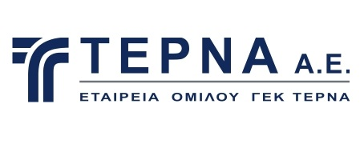




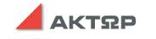

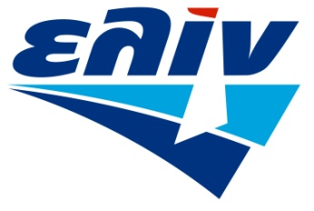







Valued Clients

Slide 24
Project References

Slide 25
Projects 1
EGNATIA S.A.: Construction of 2,5MWe solar project in the area of Evros
METKA EGN LIMITED: Construction of 5MWp PV Park in Oued zar site, Tataouine Governorate, Tunisia
AKTOR SA: Electrical construction of the Astir Hotel in Athens, Vouliagmeni
NEA ODOS SA: Electrical works for the PLC interface in tunnels of Agios Konstantinos-Kamena Vourla
SKLAVENITIS SA: Electrical construction of retail stores throughout Greece
ELIN TECHNICAL SA: Construction of Plaisio Computers store in Athens Dafni
TERNA SA: Electrical works for the construction of the new fiber optic center, lighting facilities and pillar on the Korinthou-Patron highway
TERNA SA: Reconstruction of surgery building of IATRIKO HOSPITAL in Athens, Psychiko
NEA ODOS SA: Electromechanical works in tunnels S1 and S2 of Agios Konstantinos

Slide 26
Projects 2
AGT SA: Electrical installations of subsystem 21 at Crown factory in Custines, France
NOKIA SOLUTIONS HELLAS SA: Supply and installation of new transformer, generator and chillers for X-HAUL lab in Areva
MEDIA - SATURN GROUP: Construction of office facilities, totaling 2.035 m²
AGT GROUP: Construction of MEGA SYSTEMS office facilities
HERTZ SA: Construction of office space
WIND: Construction of mobile store chain throughout Greece
GREEK MILITARY (ASDYS): Electrical construction of military facilities
TEGNATIA ENERJI URETIM SAN.VE TIC.A.S.: Construction of 5,4MWe solar project in Gaziantep, Turkey
METKA EGN LIMITED : : Construction of 10MWp PV Park in the area of Rodopi
LDK SA: Maintenance of electrical installations of the Piraeus bank facilities in Marousi Attikis

Slide 27
Projects 3
KOUMBAS SYNERGY GROUP: Reconstruction and electrical maintenance of office facilities, totaling 3.200 m²
PIRAEUS UNIVERSITY: Lighting reconstruction in the classrooms, library, and meeting rooms
DOMITIS SA: Construction of office facilities
AGT GROUP: Construction of postal savings store chain throughout Greece
IMS SA: Construction of shipping company office building, totaling 5.000 m²
HOTEL CHAMBER OF GREECE: Construction of office facilities, totaling 1.200 m²
DOMITIS SA: Construction of Agios Stefanos shopping mall
SPOT THOMPSON SA: Power resupply of office building via new low voltage network
AUTOFIX SA: Construction of office facilities and production site of LOGO company, totaling 2.000 m²
TERNA SA: Electrical construction of the 1st kindergarten school of the Mandra’s municipality due to the flooding damages

Slide 28
Projects 4
McDONALD’S: Construction of stores throughout Greece
NVP SA: Construction of warehouse, totaling 3.000 m²
MEDIA - SATURN GROUP: Reconstruction & maintenance of MEDIA MARKT retail stores throughout Greece
ELIN TECHNICAL: Construction of GREEK OMBUDSMAN office building
PPC SA (Public Power Corporation): Construction of office facilities
AEGEAN AIRLINES: Construction of office space
TALLY WEIJL: Survey & construction of multinational clothing store chain throughout Greece
TEGNATIA ENERJI URETIM SAN.VE TIC.A.S.: Construction of 3MWe solar project in Cumra, Turkey
TEGNATIA ENERJI URETIM SAN.VE TIC.A.S: Construction of 7,7MWp PV Park in Karabuk, Turkey
MAPEI SA: Electrical works for the new production line in the area of Ritsona

Slide 29
Projects 5
GAIOZEFXIS LTD: Construction of accent lighting of building exterior and surroundings of office building complex, totaling 5.000 m²
TERNA SA: Construction of office space for Consortium EVROIONIA & CENTRAL GREECE MOTORWAY E-65
EYDAP SA (Athens Water Supply and Sewerage Company): Construction of office facilities throughout Athens
LAMDA LEVENTIS SA: Construction of facilities for commercial & industrial awning company, totaling 5.000 m²
EUROPΕAN NAVIGATION INC: Electrical reconstruction of shipping company facilities and replacement of medium voltage substation
QUALITY BRANDS SA: Power resupply of office building via new low voltage network
NVP SA: Construction of store and apartment complex, totaling 6.000 m²
TEGNATIA ENERJI URETIM SAN.VE TIC.A.S: Construction of 7,7MWp PV Park in Erzurum, Turkey

Slide 30
Projects 6
TERNA SA: Construction of MARE WEST shopping mall in Corinth, totaling 15.000 m²
NOKIA SOLUTIONS & NETWORKS HELLAS: Electromechanical installation of new technology laboratory in corporate headquarters
NVP SA: Construction of two-storey building, with basement & substation, totaling
2.970 m² on National Roadway Corinthos-Patras
ANTENNA GROUP: Construction of new medium voltage substation and feedback of existing low voltage load
IPPOKRATEIO HOSPITAL: Construction of A’ pathology clinic & Construction B’ cardiac surgery clinic
OTE SA (Hellenic Telecommunications): Construction of Data Center in OTE branches in the prefectures of Attica, Rethymno, Heraklion, Lassithi, Lesvos, Ilia, Lefkada, and Achaia
TERNA SA: Reconstruction of ATHENS MEDICAL surgical hospital
DELTA SA: Construction of office space and production site of dairy manufacturer

Slide 31
Projects 7
TEGNATIA ENERJI URETIM SAN.VE TIC.A.S: Construction of 4MWp PV Park in Kaman, Turkey
ILIOCHORA SA (GEK TERNA GROUP): Construction of underground municipal parking garage (600 car capacity), totaling 16.143 m2
BIOSAR SA: Construction of 5MWp PV Park in Shaftesbury Dorset, United Kingdom
GAIOZEFXIS LTD: Construction of BMS system in an office building with two basements and medium voltage substation, totaling 4.000 m²
THEMELI SA / TRAM SA: Construction of telecommunications center and Data Center of urban railway transportation company
TEGNATIA ENERJI URETIM SAN.VE TIC.A.S: Construction of 2MWp PV Park in Ilgin, Turkey
SKY SOLAR / LEA INNOVAZIONE SRL: Construction of 6MWp PV Park in Kozani, Greece
TEGNATIA ENERJI URETIM SAN.VE TIC.A.S: Construction of 5,4MWp PV Park in Ganziantep, Turkey

Slide 32
Projects 8
EUROSOL HELLAS SA: Construction of 660KWp PV station on the roof of the company ΙΚΕΑ in the area of Strovolos Nicosia, Cyprus
TEGNATIA ENERJI URETIM SAN.VE TIC.A.S: Construction of 8MWp PV Park in Corum, Turkey
NEA ODOS SA: Fiber optic interface in highway of PATHE and construction of the security systems (CCTV), Yliki area
TEGNATIA ENERJI URETIM SAN.VE TIC.A.S: Construction of 7MWp PV Park in Usak, Turkey
GENERAL SECRETARIAT FOR INFORMATON SYSTEMS (GSIS): Installation control and provision of installer solemn declaration in the main building of the Ministry in Athens, Moschato
LAMDA FLISVOS MARINA SA: Installation and maintenance of Flisvos boat yard in Faliro Athens
NVP SA: Construction of electric-armored telecommunications centre (Control Room) for the Ministry of Foreign Affairs
ELIN TECHNICAL: Renovation of seven store branches of Piraeus Bank in Athens, Corinth, and Chios Island

Slide 33
Projects 9
TERNA SA: Construction of 14.99 MW PV park located in the Municipality of Eordea, Kozani
JUWI HELLAS: Construction of 204 MW solar park in Kozani region, in the northern part of Greece.
J&P-AVAX-TERNA SA: Electrical construction of an integrated casino resort that will include a 16-storey hotel tower with approximately 500 guest rooms, a casino, restaurants, retail and commercial areas, with indoor and outdoor pools, spa, expo building and an assortment of other main and auxiliary areas and facilities, sports facilities as well as extensive landscaped areas in Cyprus, Limassol, City Of Dreams.
TERNA SA: Electrical construction of nine floor office and store space with six basements in Athens, L. Kifisias 115-Orbit
METKA EGN LIMITED : Construction of 10MWp PV Park in Qom, Iran
METKA EGN LIMITED : : Construction of 25MWp PV Park in Baikonur, Kazakhstan
TERNA SA: Electrical construction of ten floor hotel with tree basements, roof garden and swimming pool in Athens, Makrygianni area
TERNA SA: Electrical construction of ten buildings of the project AIS Ptolemaida-Study, procurement, transportation and installation of V steam power plant mixed power of 660MWel

Slide 34
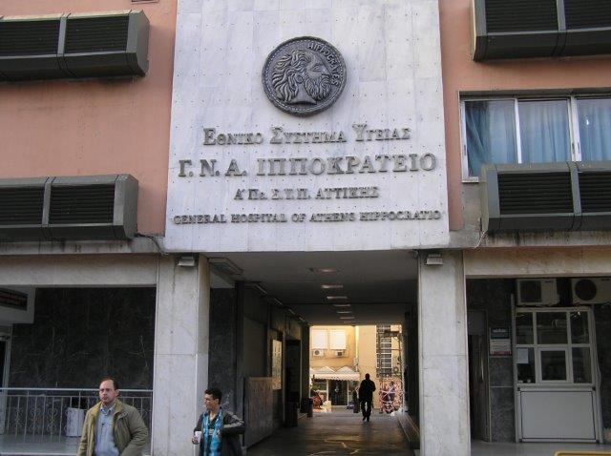
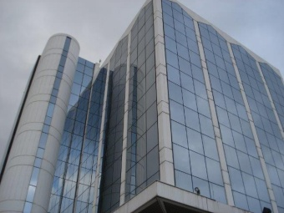
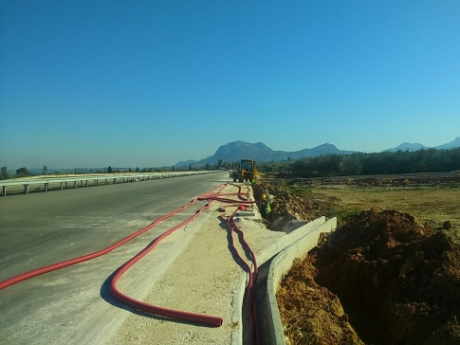
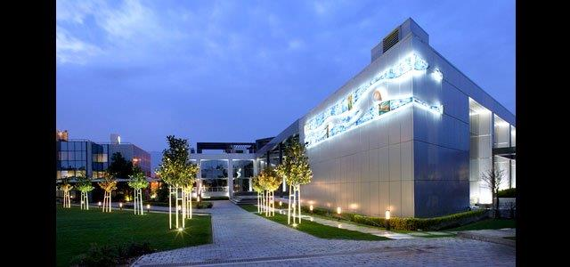
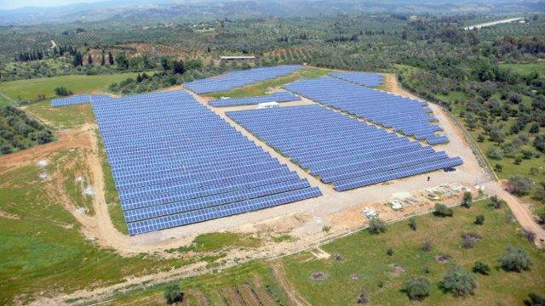
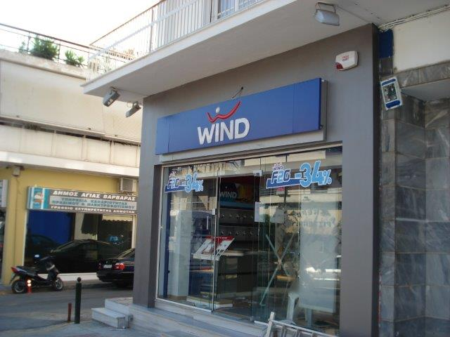
Gallery 1
IPPOKRATIO HOSPITAL
KOUMBAS SYNERGY GROUP
NATIONAL ROADWAY
ELIN CORPORATE OFFICE
PV PLANT IN SPARTA
WIND RETAIL CHAIN

Slide 35
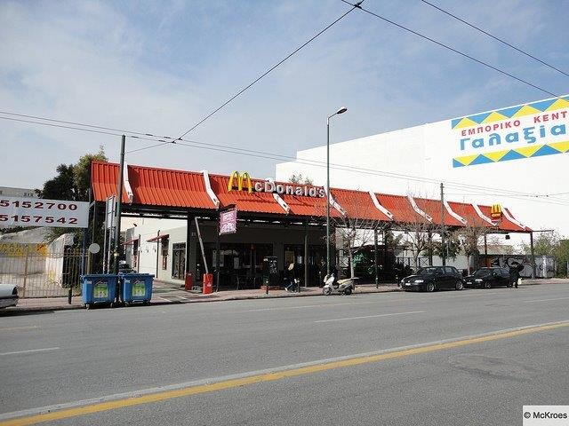
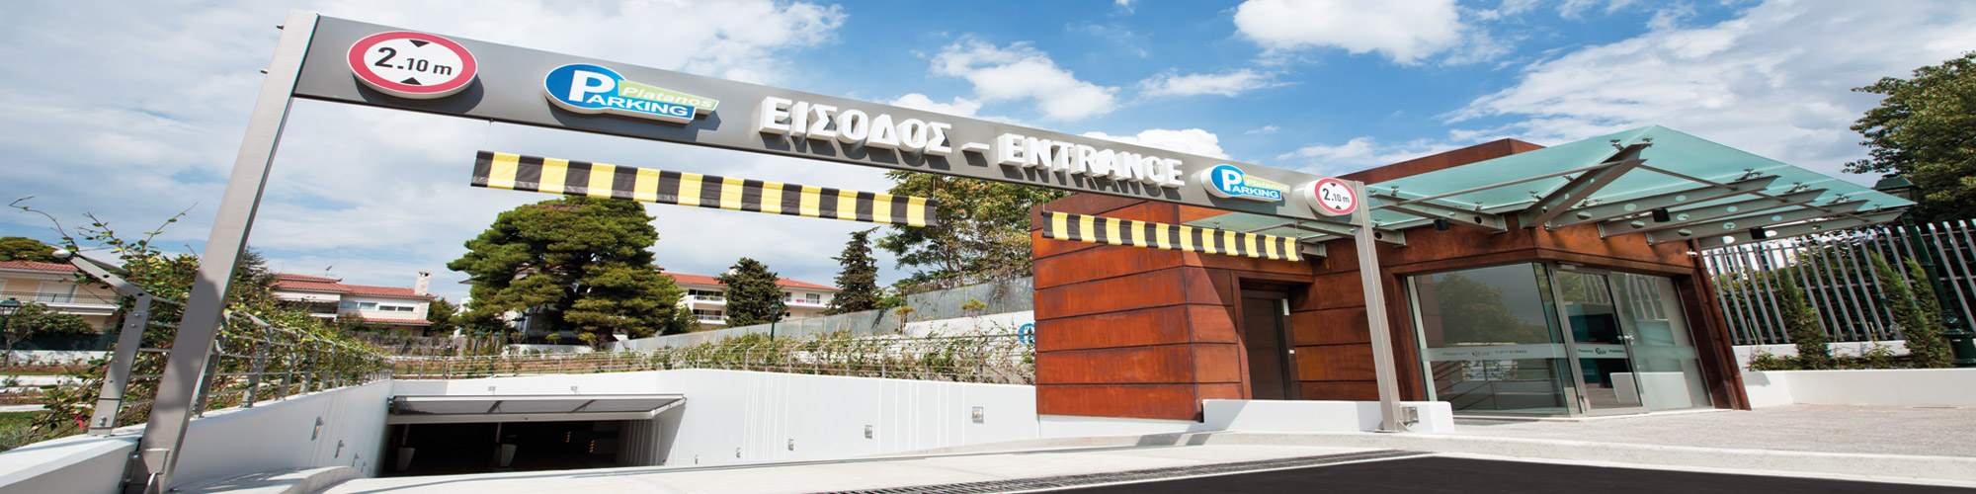
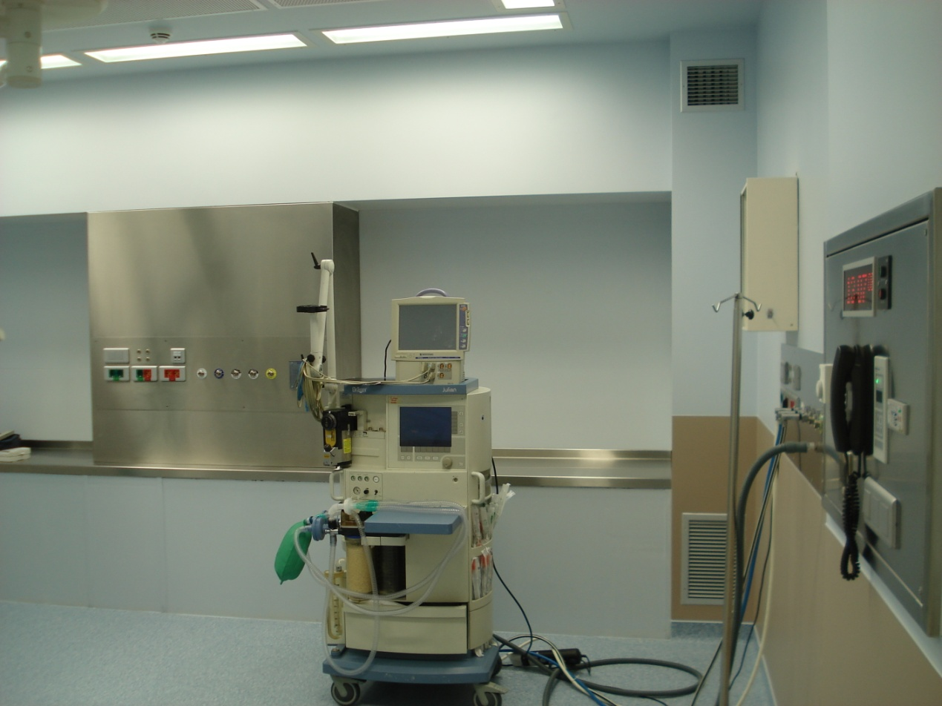
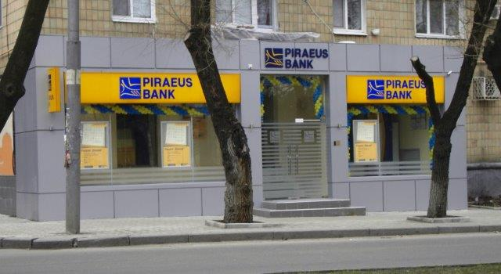
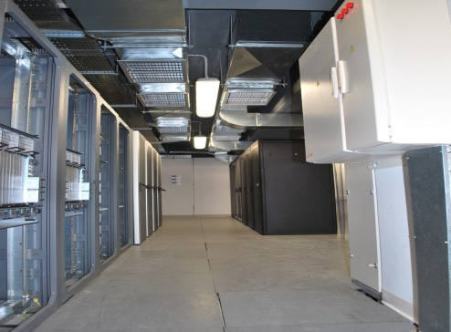
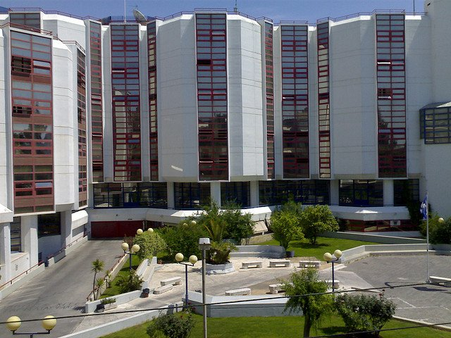
Gallery 2
McDONALD’S
FOOD CHAIN
KIFISIA MUNICIPAL PARKING GARAGE
ATHENS MEDICAL CENTER
PIREAUS BANK
NOKIA SOLUTIONS & NETWORKS HELLAS
UNIVERSITY OF PIREAUS

Slide 36
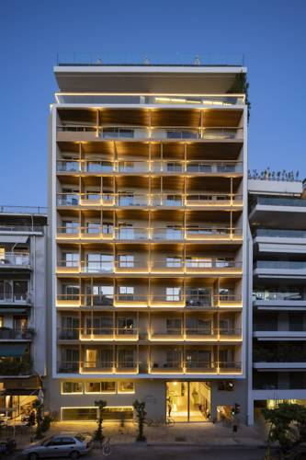
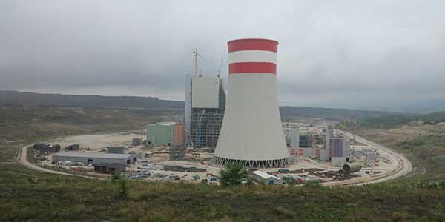
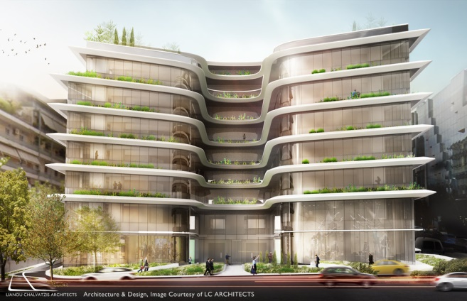
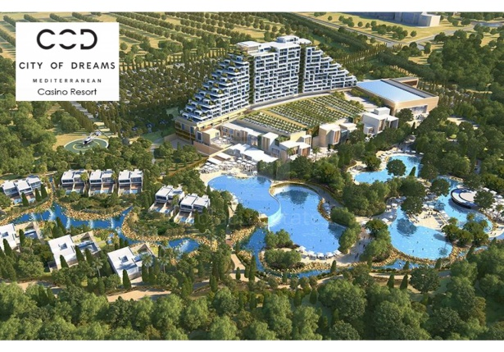
Gallery 3
ATHENS BC COCOMAT
5th UNIT AIS PTOLEMAIDA
NOVAL ORBIT
ATHENS
CITY OF DREAMS MEDITERRANEAN
¨INTEGRATED CASINO RESORT¨ CYPRUS

Slide 37
Benefits At-a-Glance

Slide 38




Premium Quality - Our company works relentlessly to provide the best quality installation, maintenance, and consulting services related to every application of electricl & mechanical construction
Extensive Technical Know-How - Our team is comprised of professionals with years of experience in a broad spectrum of large-scale commercial & industrial construction projects
State-of-the-Art Equipment - Our continuous investment in new technologies, specialized tools, and advanced measurement instruments guarantees the effectiveness of each project undertaken
Rapid Speed of Service - We respond quickly to your needs and remain well within the given time constraints, regardless of the project size or the level of complexity

Slide 39



Tailor-made Services - Staying true to our client-oriented philosophy, we customize our services and create solutions that cover your exact needs and project specifications
Strict Safety Measures - We ensure that every possible health & safety precaution is taken, in order to guarantee secure construction sites for both our staff & clients
Wide Geographic Reach - We have the qualified manpower needed to undertake projects anywhere in Greece or beyond, and designate a highly-skilled construction team to cater to your every need

Slide 40
Contact Us For Further Information
A&G Chatzichristofas ​​Single Member Ltd.
Larnakos 3, Alimos- Athens, Greece 17455
Τ: 0030-210 9827359, 0030-210 9827420, 0030-210 9813813
F: 0030-210 9827379
A&G Powering Construction UK Ltd.
393 Lordship Lane, London, N17 6AE United Kingdom
Τ: 0208 801 0858
F: 0208 808 8122
AVEG ENERJI INSAAT SANAYI VE TICARET LIMITED SIRKETI
Katip Mustafa Celebi Mah., Tel. Sok. No:6/3 Beyoglu, Istanbul, Turkey
T: 021 22493373
AVEG POWERING CONSTRUCTION LTD
23 Dromos, 4, Episkopi, 4620, Limassol, Cyprus
T: 00357 99798766
AVEG POWERING CONSTRUCTION LTD
Nasser Khosro, Bazar Marvi, Khomayoun Zandiye, 26, TX 1116957469, Iran
T: 009809058196895
info@angworks.gr, www.angworks.gr

